Slide 1
Modul Pembelajaran [Kode Modul]
[NAMA MODUL]
Page ini diisi oleh Telkom
Pathway | :
Sub Pathway | :
Kompetensi | :
Key Element | :
Level | :
Developer | :
Approval | : | 1. Mgr Learning Development 2. SM School of Dig Platform & Service
Sesuai Dirkom-10
Nama/ NIK/ Bidang
Atau Nama Vendor
Rev. : 00
Created/Last Modified : 10-2021

Slide 2
Modul Pembelajaran | : | React JSX
Deskripsi Modul | : | React JSX adalah syntax HTML yang diinput dalam Javascript agar bisa membikin komponen user-interface secara modular, dinamis, dan gampang diolah.
Enabling Learning Objective | : | Memahami tentang React JSX dan bagaimana bisa menggunakan nya untuk komponen UI
Daftar Topik | : | Why use JSX ? Nested Elements in JSX JSX attributes JSX comments JSX styling | 6. Installation
Searching Keyword | : | ReactJS create-react-app JSX XML Virtual DOM styled-components

Slide 3



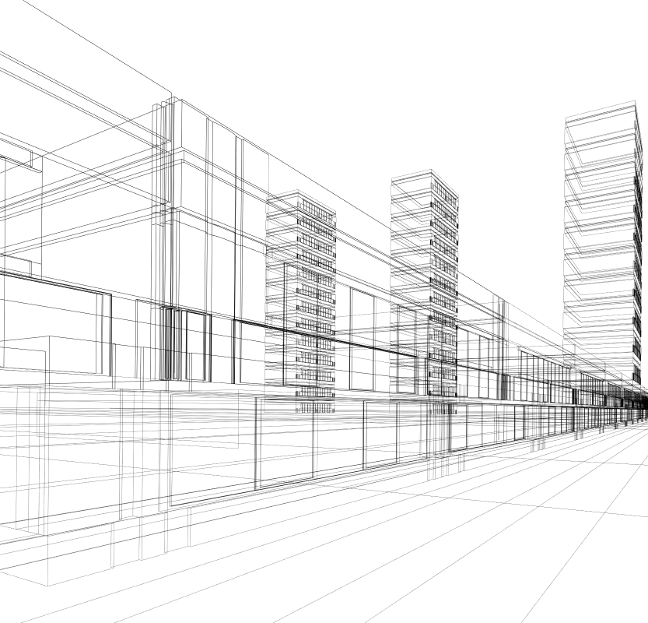
REACTJS
React JSX
Calvin Susanto Putra

Slide 4
Table of Contents
Why use JSX ?
Nested elements in JSX
JSX attributes
JSX comments
JSX styling

Slide 5
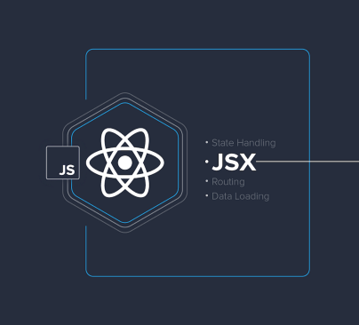
Why use JSX ?
stands for Javascript XML, it is a form of HTML written in Javascript and used to build React UI components
can access a virtual DOM, which replicates the real DOM of a standard HTML document and perform real-time updates to the structure
allows for the inclusion of programming logic to directly handle states and events from the user
has an active developer community and official documentation, surpassing jQuery as the most popular web developer framework by 40.14%
https://javascript.plainenglish.io/smart-ways-to-write-jsx-in-your-react-app-f435aa12bb96

Slide 6
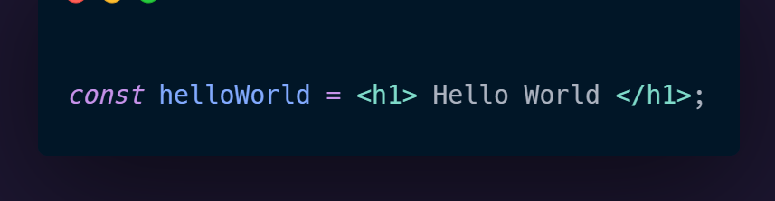
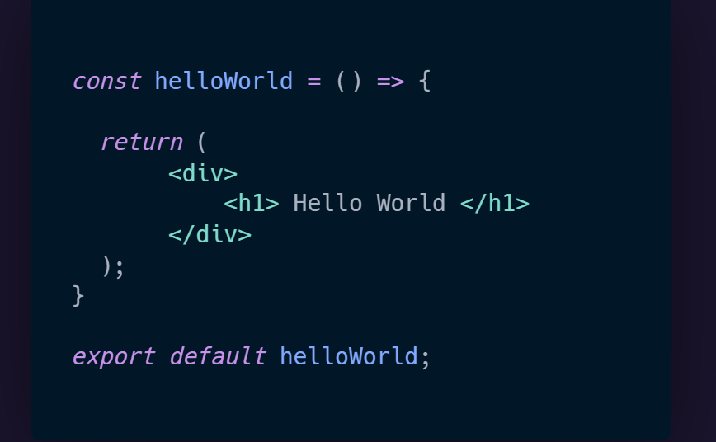
Why use JSX ?
An example of JSX as a variable declaration:
Another example as a React component:

Slide 7

Nested Elements in JSX
JSX allows for the nesting of elements as components within other Javascript files
compatible files are in ‘.js, .jsx, .ts, .tsx’ format, where ‘TS’ stands for Typescript, a more advanced class-based language derived from Javascript
.
this allows for components or elements to be utilized and reused in multiple ways and sections
https://www.rigelnetworks.com/using-virtual-dom-react-js-top-5-benefits/

Slide 8
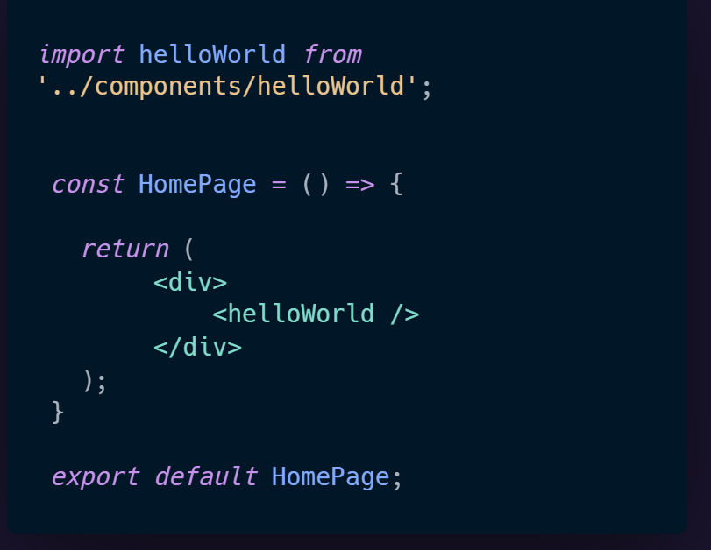
Nested Elements in JSX
Nesting the helloWorld component in another React element; i.e. HomePage.jsx

Slide 9
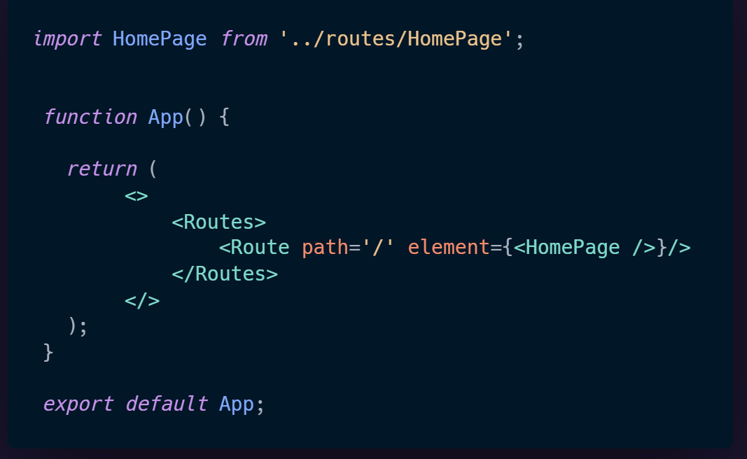
Nested Elements in JSX
Nesting the HomePage component into the App.js file; the application is wrapped with a BrowserRouter to render pages

Slide 10

JSX attributes
JSX attributes ae written in a syntax not too dissimilar from those of a normal HTML document
differences in JSX to HTML attribute types include the conversion of ‘class’ to ‘className’, due to the former being a reserved keyword in Javascript
Otherwise, custom attributes for elements could also be created with a ‘data-’ syntax
For example, ‘data-testCase’
https://www.pngdownload.id/png-vtxmg7/download.html

Slide 11
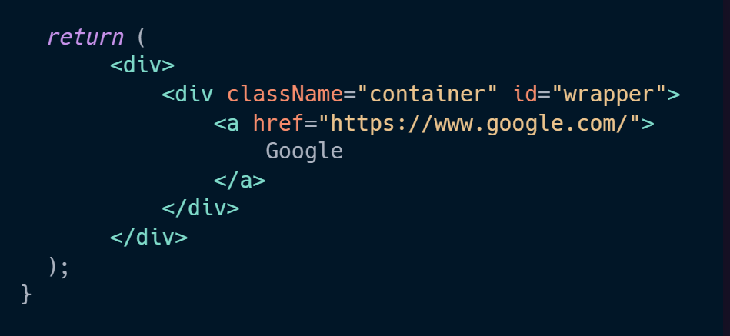
JSX attributes
An example of JSX attributes in use:

Slide 12
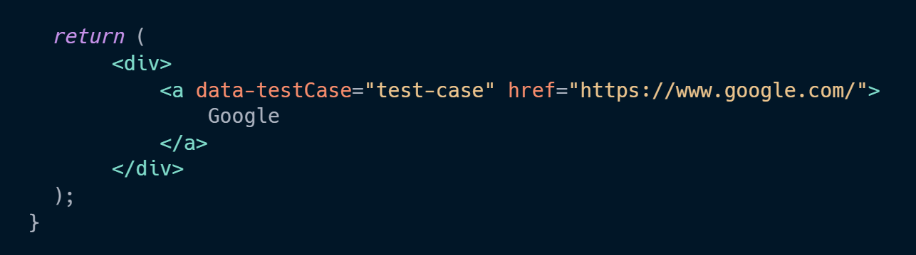
JSX attributes
For the implementation of custom attributes:

Slide 13
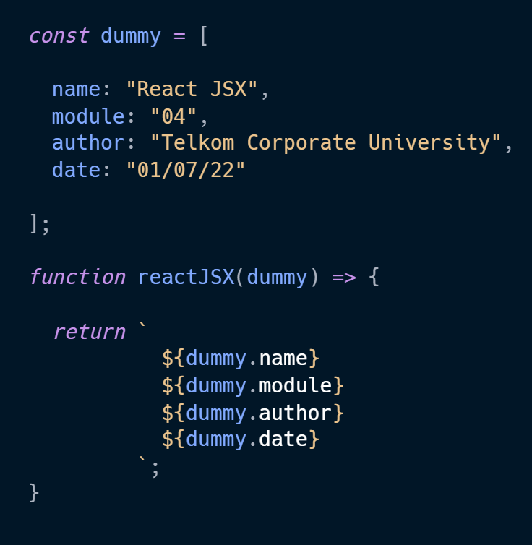
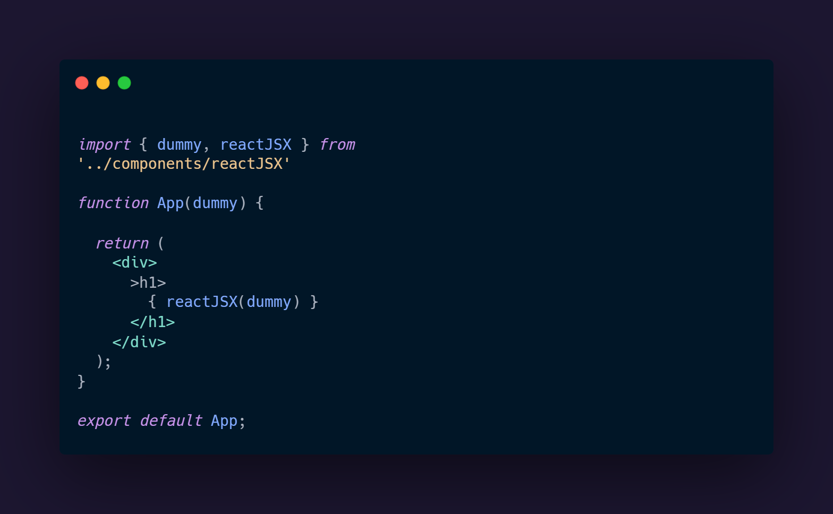
JSX attributes
More advanced examples of JSX attributes allows users to perform callbacks on functions and variables

Slide 14
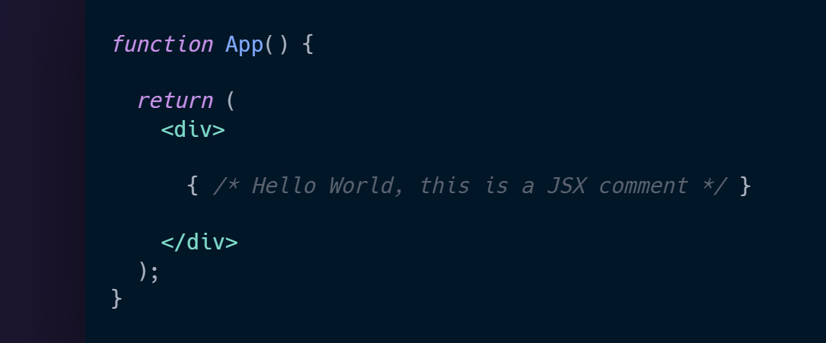
JSX Comments
the difference in React JSX, is that comments are written as both a block comment with curly braces
.comemnts are used to notify or deliver information about the code, making it vital for documentation and refactoring purposes

Slide 15
JSX Comments
the difference in React JSX, is that comments are written as both a block comment with curly braces

Slide 16

JSX Comments
comments in JSX can be written anywhere in the code regardless of structure, assuming that the aforementioned syntax is used
comments are used to notify or deliver information about the code, making it vital for documentation and refactoring purposes
https://dryicons.com/icon/code-file-icon-5845

Slide 17
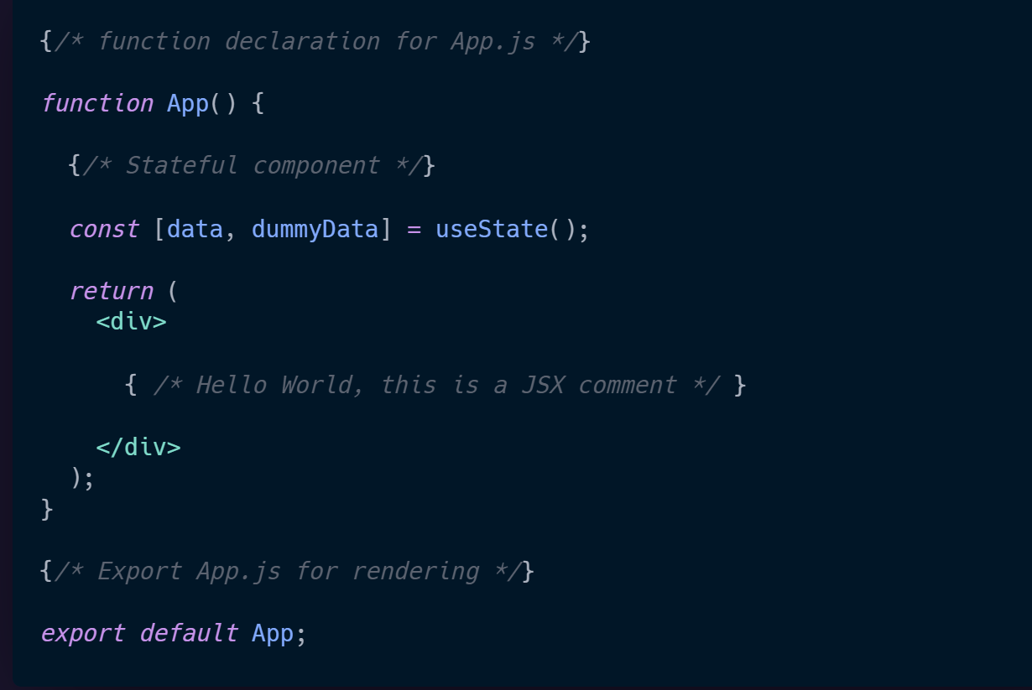
JSX Comments
An example in appropriate comment usage describing App.js:

Slide 18




JSX Styling
styling in JSX can be done with various methods, all of which are supported internally and externally
the primary method of styling requires a index.css file stored in the “src” folder; all styling done in this file will affect any JSX elements in App.js
Otherwise, inline-styling and external frameworks or libraries are available with NPM

Slide 19
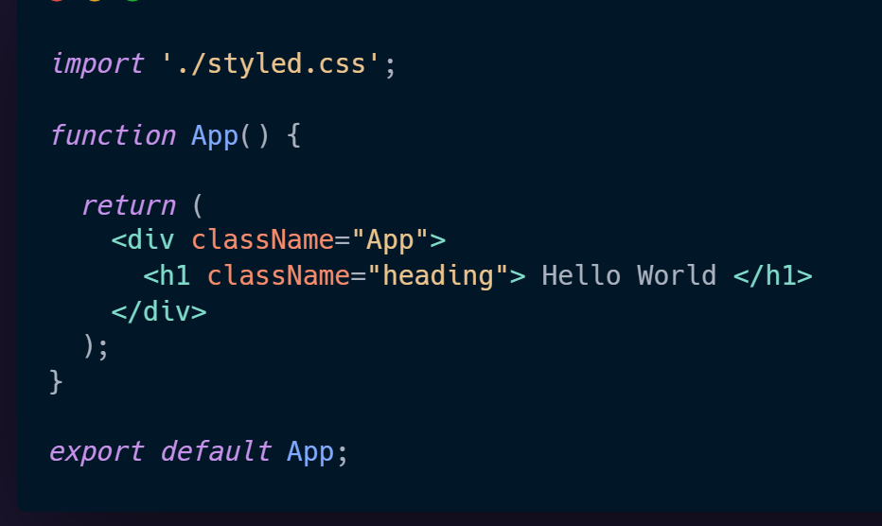
JSX Styling
styling JSX conventionally requires the style.css file to be imported, with standard attribution:

Slide 20
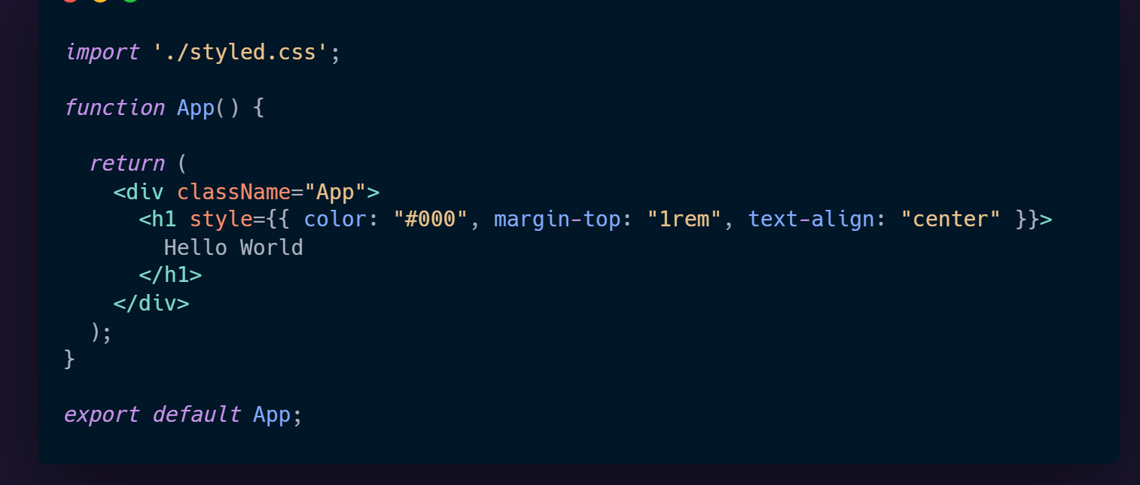
JSX Styling
An example of inline-styling in JSX:
.
.inline-styling passes an object to the style property of ‘color’, ‘margin-top’, and ‘text-align’

Slide 21
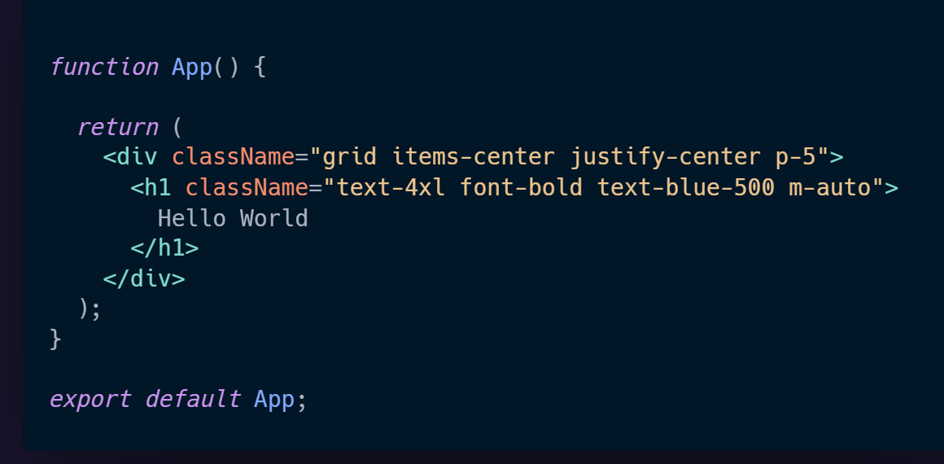
JSX Styling
Otherwise, external libraries or frameworks could be installed using the ‘npm install’ command in a Node.js terminal
An example of the external framework, Tailwind CSS, being used to style a component

Slide 22
References
https://reactjs.org/docs/introducing-jsx.html
https://create-react-app.dev/
https://riptutorial.com/reactjs/example/3846/nesting-components
https://medium.com/@ralph1786/how-to-style-react-components-5b3111d77ab2

Slide 23
REACTJS
React JSX
Calvin Susanto Putra

Slide 24
Kelengkapan Modul
Pre & Post Test (minimal 10 soal, pilihan ganda a-d)
Pre Reading
Teaching Notes
Referensi

Slide 25
Assessment – [Pre & Post Test]

Slide 26

Pre-Reading
ReactJS is a Javascript library for building user interfaces. This PDF ebook is a portable offline reference guide for the community, can be printed or synced with your kindle for a better reading experience. It's based on ReactJS version v.16.13.1
This is an excellent reference format for ReactJS beginners, is not a tutorial just the official documentation for your reference

Slide 27
TEACHING NOTES*
Lesson/Topics
Case Study
Clips
Games
Others : . . . . . . . . . . . .
OBJECTIVES
PERSIAPAN
Memahami tentang JSX dan penggunaan nya untuk bikin komponent
Offline: Laptop
Online: Link Zoom
OVERVIEW
DIRECTION
React JSX adalah syntax HTML yang diinput dalam Javascript agar bisa membikin komponen user-interface yang modular dan gampang diolah.
Menjelaskan kepentingan JSX untuk bikin komponen dalam proyek React
.
Menjelaskan perbedaan atribut dan komen diantara syntax web development biasa
Demontrasikan metode untuk style elemen atau komponen JSX
Mengatur dan mengelola arah dan jalan-nya diskusi;
Memberikan contoh-contoh, kasus dan ilustrasi;
Memberikan apresiasi dalam tanya jawab;
Memberikan debrief atau insight/pesan dari kegiatan;
Memberikan dan menyampaikan kesimpulan dan di tiap sesi atau di akhir sesi
PERALATAN YANG DIBUTUHAN
Offline : Laptop
Online: Link Zoom
*Catatan : jumlah halaman teaching Note dapat ditambah seauai kebutuhan

Slide 28
TEACHING NOTES 2/2*
DIRECTION
Section (slide/clip/case/etc) | Activities (Hal apa yang akan dilakukan untuk setiap section-nya) | Description (hal-hal spesifik yang harus dilakukan, misal : penjelasan dan atau penekanan materi, pengelolaan arah dan jalannya diskusi, wrap up/insight atau debrief, etc)
5-6 | Presentasi, Diskusi | Menjelaskan kepentingan JSX untuk membikin komponen dalam proyek React
7-9 | Presentasi, Diskusi, Case Study | Menjelaskan tentang penggunaan nested elements dalam ReactJS
10-13 | Presentasi, Diskusi, Case Study | Menjelaskan tentang atribut dan tipe data untuk JSX
14-17 | Presentasi, Diskusi, Case Study | Menjelaskan tentang syntax, penggunaan, dan kepentingan komen di JSX
18-21 | Presentasi, Diskusi, Case Study | Menjelaskan metode untuk styling elemen ReactJS

Slide 29
References
Ilya Kantor (2022), “Error handling, "try...catch"”, https://javascript.info

